Slide 1
Dung Beetles Associated with Bison- and Cattle-grazed Pastures Protocols and Ideas Feb. 10, 2022

Slide 2
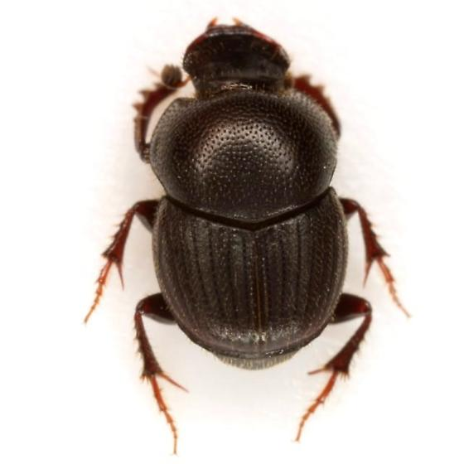
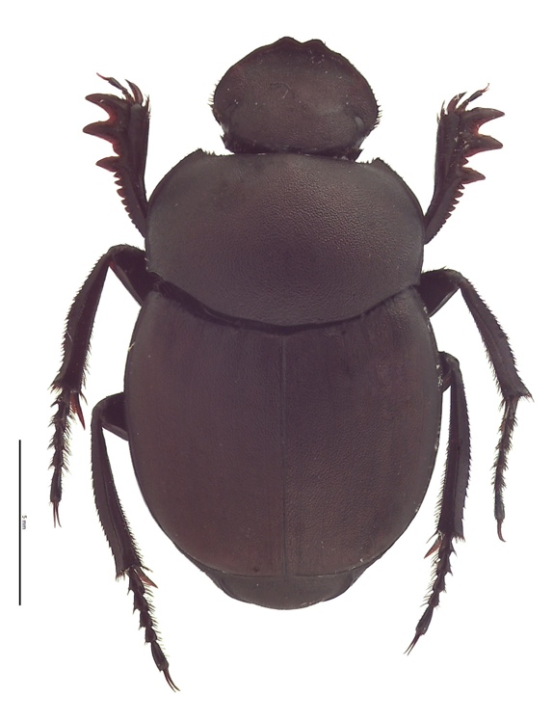
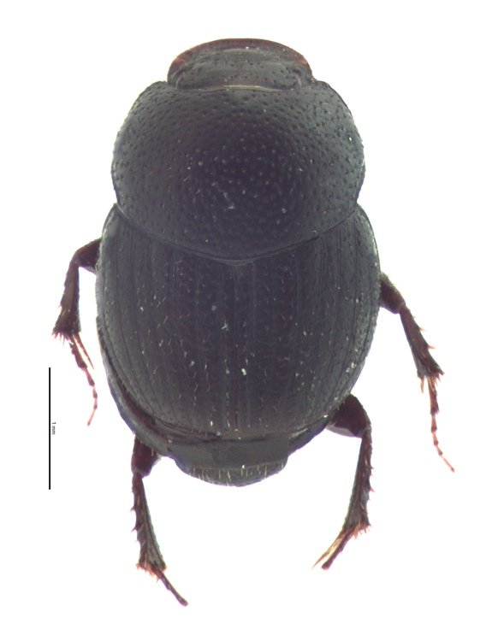
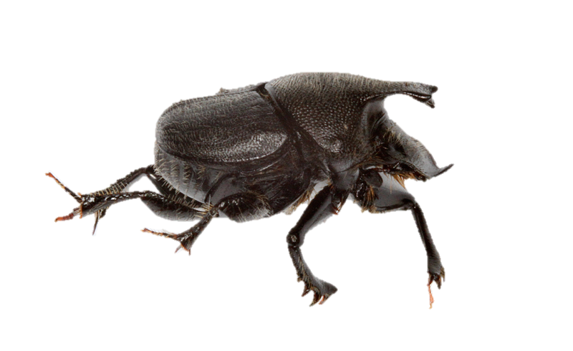
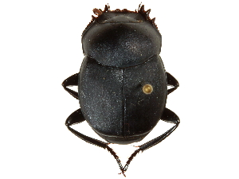
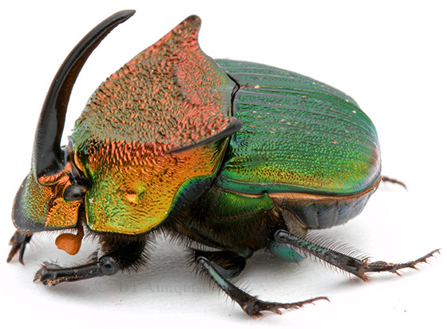
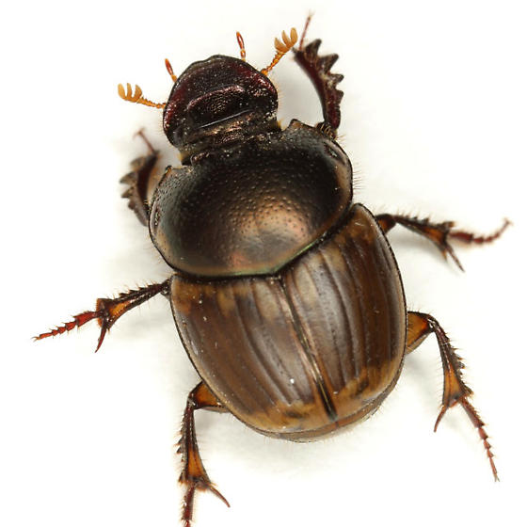
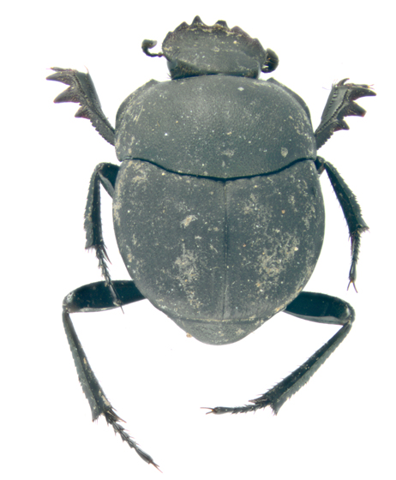
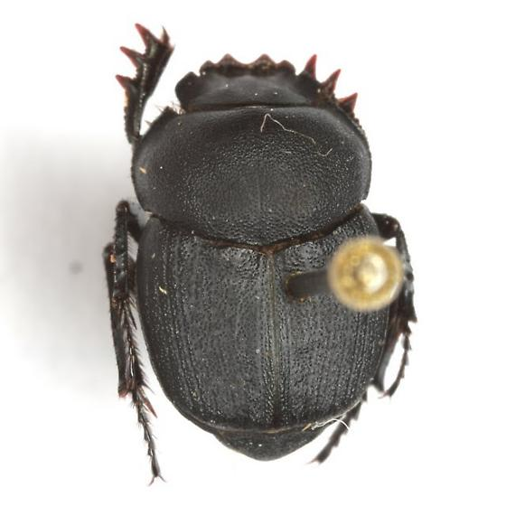
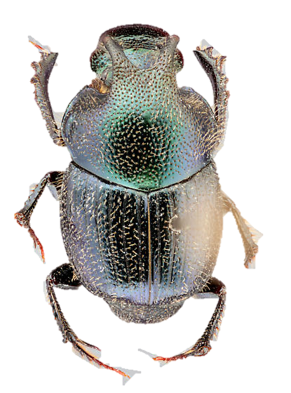
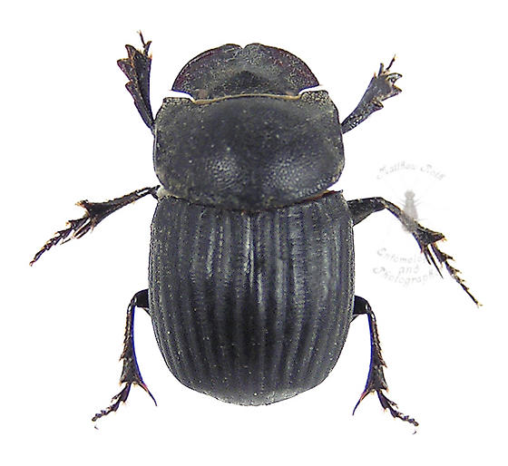
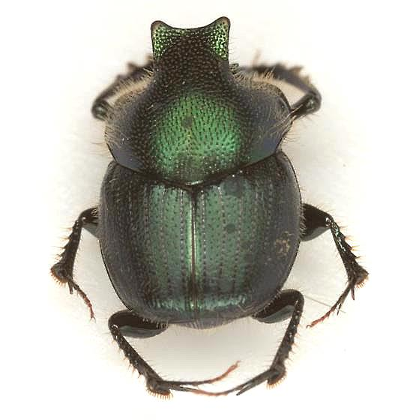
1.
Onthophagus
pennsylvanicus
3.5-5 mm
2.
Canthon
pilularius
12-19 mm
3.
Onthophagus
oklahomensis
2 - 4.1mm
4.
Phanaeus
vindex
11-22 mm
5.
Onthophagus
hecate
5.2-9.5 mm
6.
Canthon
vigilans
13-20 mm
7.
Digitonthophagus
gazella
10-13 mm
8.
Melanocanthon nigricornis
6.5-8.7 mm
9.
Onthophagus
medorensis
6 -8 mm
10.
Canthon
ebenus
7- 10 mm
11.
O. Orpheus
pseudorpheus
5 -9 mm
12.
Copris
fricator
10-16 mm
1: O. pennsylvanicus photo Mike Quinn © 2009 via Bugguide.net; 2: C. pilularius photo Emmy Engasser © 2016 via idtools.org; 3: O. oklahomensis photo Emmy Engasser © 2016 via idtools.org ; 4: P. vindex photo David Almquist © 2011 via Bugguide.net ; 5: O. hecate photo Bill Hubick © 2014 via Marylandbiodiversityproject.com; 6: C. vigilans photo via Boldsystems.org ; 7: D. gazella photo Mike Quinn © 2013 via Bugguide.net; 8: M. nigricornis photo MJ Hatfield © 2014 via Bugguide.net ; 9: O. medorensis photo Mike Quinn © 2009 via Bugguide.net ; 10: C. ebenus photo Mike Quinn © 2010 via Bugguide.net; 11: O. orpheus pseudorpheus photo Chris Grinter © 2013 via Bugguide.net; 12: C. fricator photo Matthew Roth © 2006 via Bugguide.net
Dung Beetle Species of the Red Hills of Kansas

Slide 3
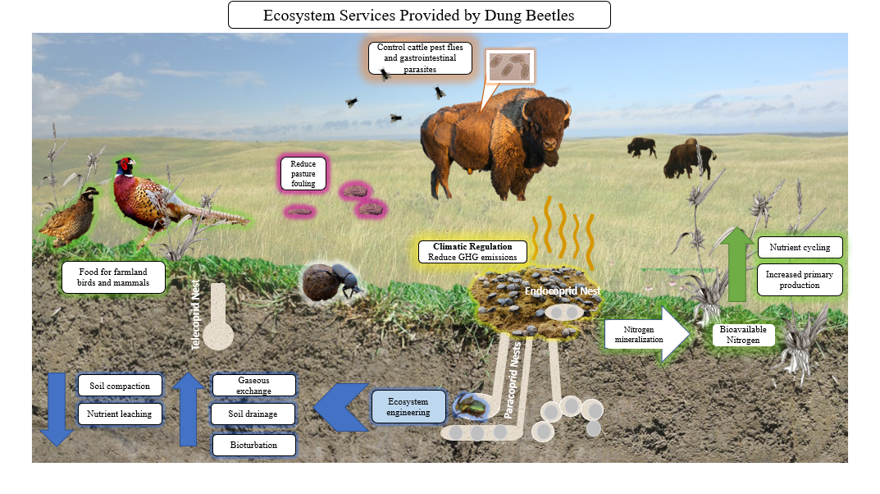
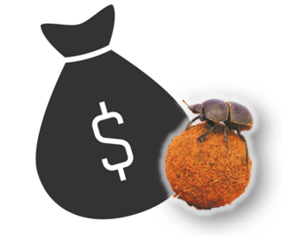
$380 million annual impact on the U.S. cattle industry (Losey & Vaughan 2006).
©Morgan Trible

Slide 4
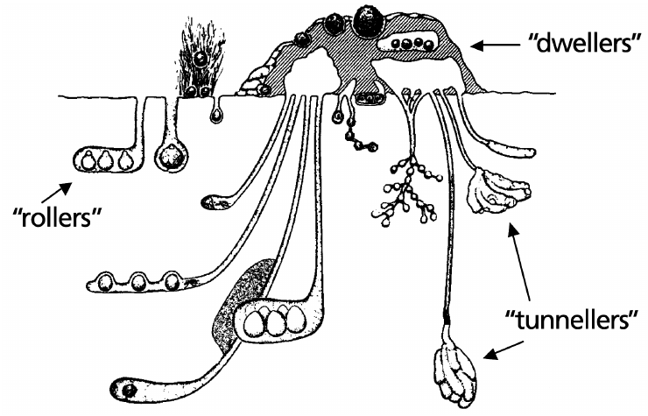
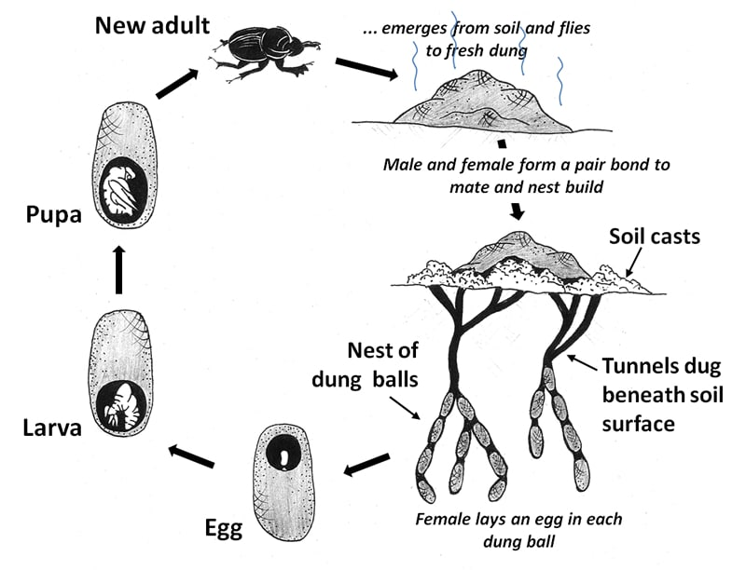
Notes:
Dung beetle life cycle: https://www.hluhluwegamereserve.com/dung-beetle-facts/ Hluhluwe Game Reserve

Slide 5
Rationale
•Dung beetles are soil engineers that improve pastures for grazers, increase the water retention capacity of the soil, reduce flies and parasites, and increase carbon sequestration
•Foraging behaviors of cattle and bison could impact vegetation structure and drive differences in dung beetle communities
•Dung beetle community analyses that compare bison- and cattle-grazed grasslands are lacking
•Preliminary research in Kansas provides evidence that dung beetle communities differ, and these results may have implications for grasslands management

Slide 6
Challenges to Cattle Ranching
• Methane production; carbon and cattle
• Pasture fouling, flies, parasites
• Diminished water resources; water contamination with feces; erosion
• How to reduce harm to the environment (e.g., carbon sequestration)
• Diseases, pathogens, tick-borne diseases that impact cattle
• Soil legacy effects of de-wormers
• Climate change and grassland changes
• Other:
Meat protein substitutes
Invasive species: mammals, grasses, chronic wasting disease in white tail deer
Landowners who are aged and the next generation not interested in ranching
Land being purchased by out-of-state people who do not maintain/manage the land

Slide 7
Gaps in Knowledge
•Carbon sequestration potential (value to landowner and ecosystem)
•Legacy effects of ivermectins and permethrins
•Soil productivity and “health” (value for landowner and ecosystem)
•Management impact on soil N retention
•Implications for grasslands management (impact on grassland diversity and habitat heterogeneity)
•Differential impacts on dung beetle guilds (tunnelers are better dung recyclers but the most impacted by ivermectins)
•Is higher dung beetle abundance correlated with increased above-ground biomass?
•Are dung beetle communities associated with soil types?
•Impacts of fire on dung beetles?
Notes:
From Hanberry et al. 2021. “Ungulate herbivory, particular grazing by 30−60 million bison, exerted a strong selective force on Great Plains vegetation, and plants in the region evolved characteristics that helped them with- stand high grazing pressure (Mack and Thompson 1982; Milchunas et al. 1998; Gates et al. 2010). Dominant herbivores in the region are now livestock, primarily cattle (Derner et al. 2009). Because of the historical importance of bison and other ungulates in Great Plains grasslands, livestock grazing is a management tool often used to recreate the functional role of disturbance historically associated with bison (Steinauer and Collins 1996; Fuhlendorf and Engle 2001; Derner et al. 2009). Some of these roles may benefit pollinators, including increasing habitat heterogeneity and plant diversity that may result from selective feeding on grass, pref- erential grazing on recently burned areas, and patchy excrement deposition (Steinauer and Collins 1996; Hickman et al. 2004). Other effects of livestock may positively or negatively influence pollinators, including alteration of blooming flower abundance and diversity, physical structure of vegetation, soil characteristics, and microhabitat temperature and moisture (see Fig. 2; Fleischner 1994; DeBano 2006b; Kimoto et al. 2012b; Schmalz et al. 2013; Moranz et al. 2014; Buckles and Harmon-Threatt 2019)."

Slide 8
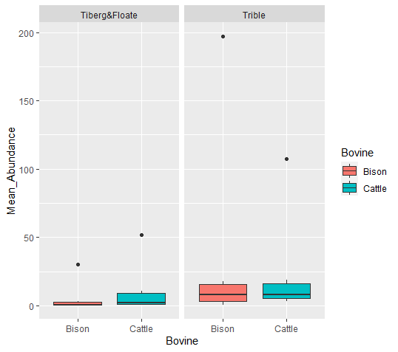
Status of Current Knowledge
Tiberg & Floate (2011) compared the response of dung beetles to the dung of cattle versus bison on different diets in order to test the “extant” hypothesis (Bison-associated dung beetles persist in cattle dung) versus the “extinction” hypothesis (a subset of bison-associated dung beetles were unable to make the transition to cattle and have gone extinct.
Tiberg & Floate (2011) addressed abundance, but they did not address dung beetle community composition.
A comparison of two data sets: the mean abundance of dung beetles associated with bison and cattle (Tiberg and Floate 2011; Trible 2021).
Notes:
Tiberg, K., & Floate, K. D. (2011). Where went the dung-breeding insects of the American bison?. The Canadian Entomologist, 143(5), 470-478.

Slide 9
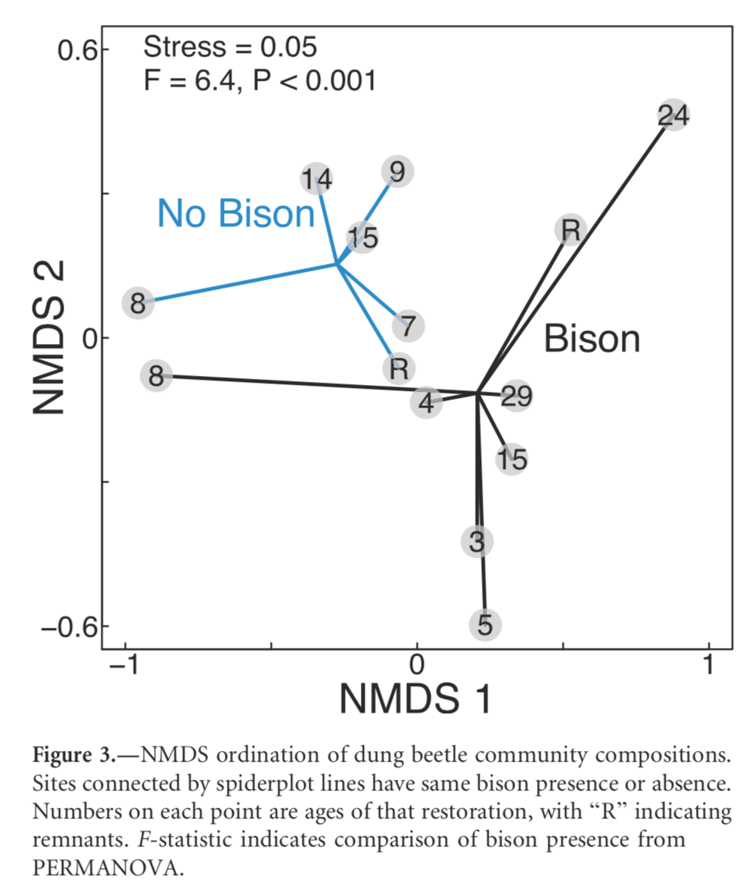
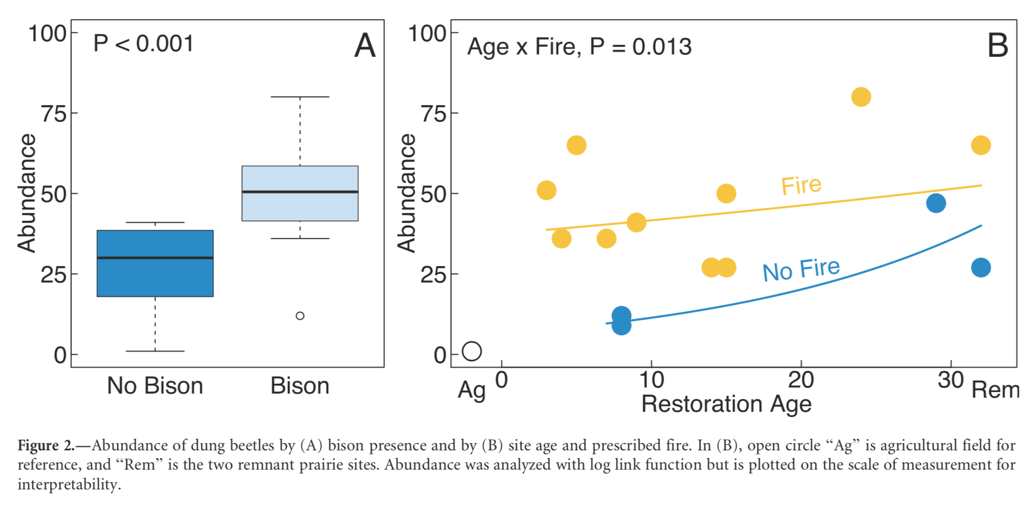
Status of Current Knowledge
Barber et al. (2019) conducted small-scale research (1 year, 2 pitfall traps) to examine the response of dung beetles to bison reintroduction following grassland restoration in Illinois. The researchers did not compare bison and cattle (or other herbivore).
They did not compare bison and cattle.
Notes:
Barber, N. A., Hosler, S. C., Whiston, P., & Jones, H. P. (2019). Initial responses of dung beetle communities to bison reintroduction in restored and remnant tallgrass prairie. Natural Areas Journal, 39(4), 420-428.

Slide 10
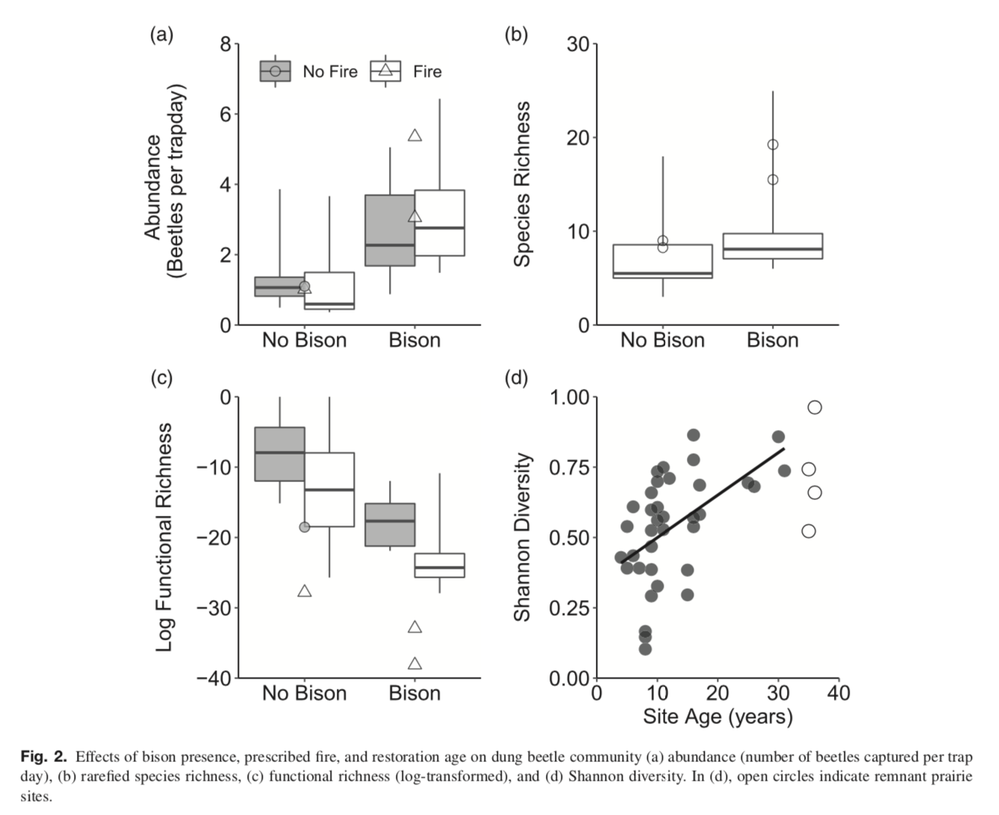
Status of Current Knowledge
Using the same restorations in Illinois, Hosler et al. (2021) examined “species and functional trait composition of dung beetle communities across a 3-31 year chronosequence of restored prairies, in which sites varied in the presence of re-introduced bison and prescribed fire… We also performed a dung decomposition experiment to measure an ecosystem function driven by these insects.”
They found that Bison doubled beetle abundance and increased richness; restoration age doubled diversity. Additionally, they found that dung decomposition was unaffected by site but increased mean beetle mass.
They did not compare bison and cattle.
Notes:
Hosler, S. C., Jones, H. P., Nelson, M., & Barber, N. A. (2021). Management actions shape dung beetle community structure and functional traits in restored tallgrass prairie. Ecological Entomology, 46(2), 175-186.

Slide 11
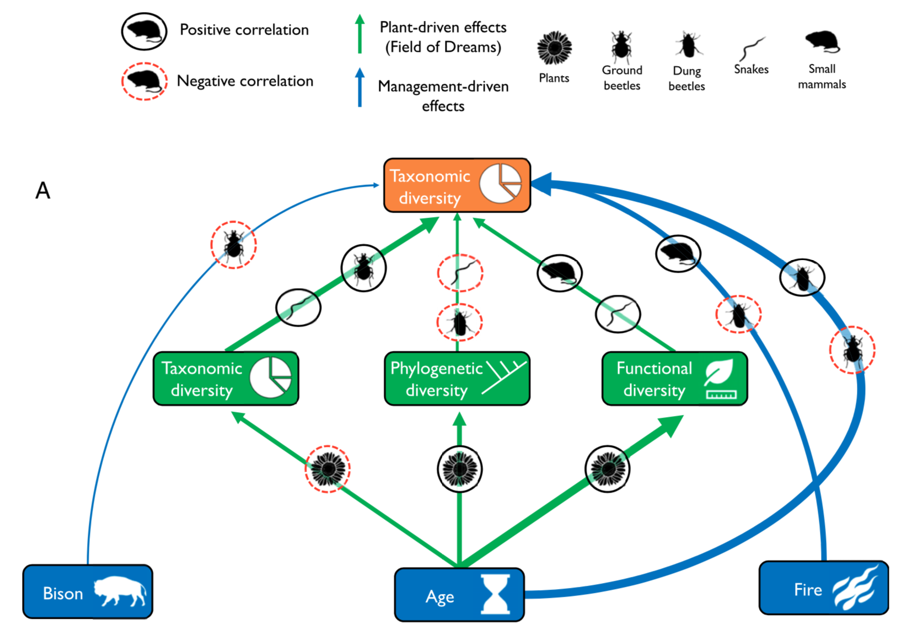
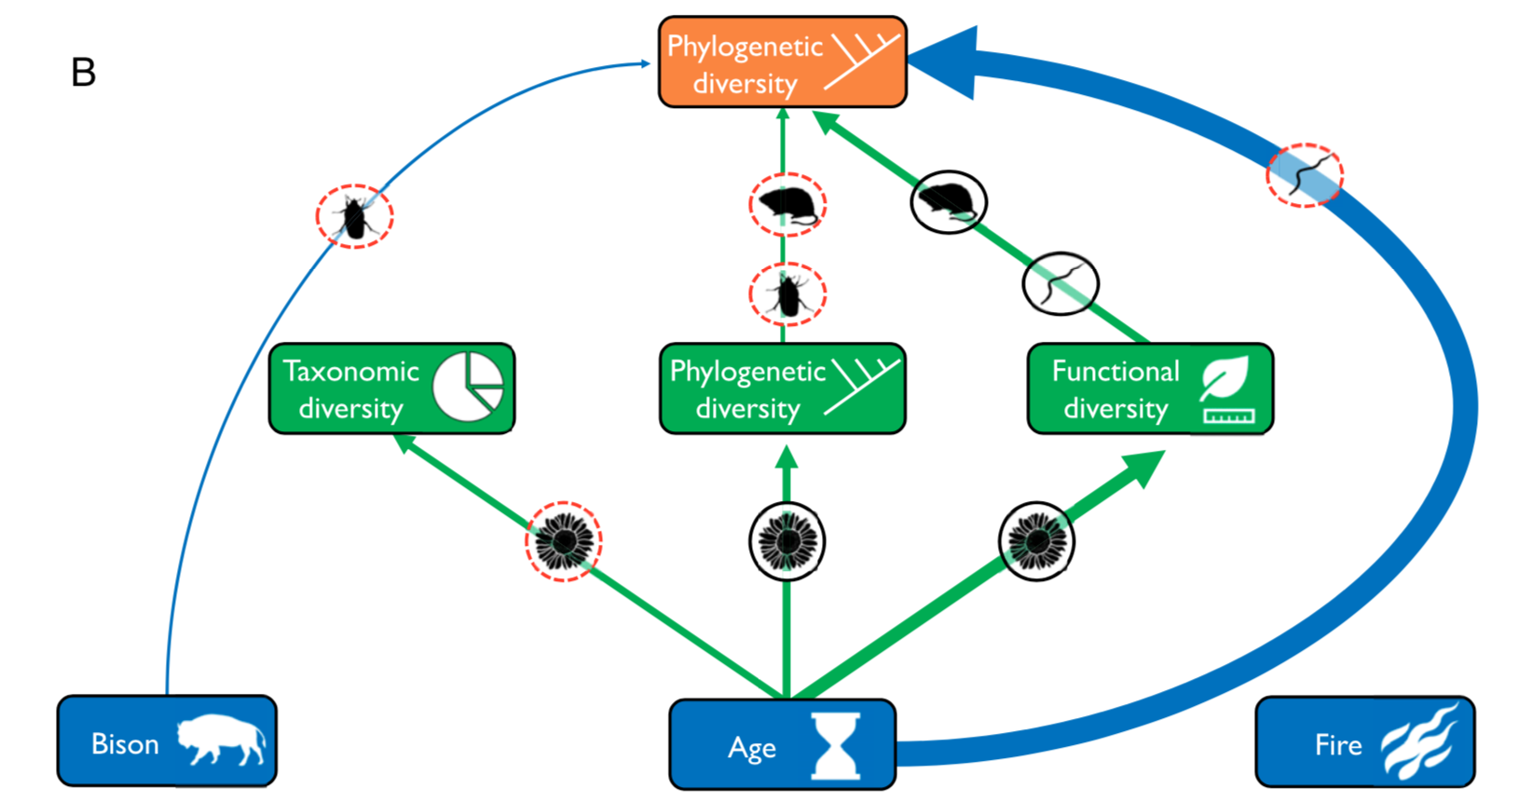
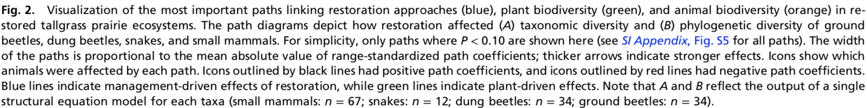
Status of Current Knowledge
Using the same restorations in Illinois, Guiden and Barber (2020) used SEM modeling to examine management-driven effects on animal communiites, including dung beetles. Dung beetles were sampled for 2 years using 2 pitfall trap arrays with 5 pitfall traps.
They did not compare bison and cattle.
Notes:
Barber, N. A., Hosler, S. C., Whiston, P., & Jones, H. P. (2019). Initial responses of dung beetle communities to bison reintroduction in restored and remnant tallgrass prairie. Natural Areas Journal, 39(4), 420-428.

Slide 12
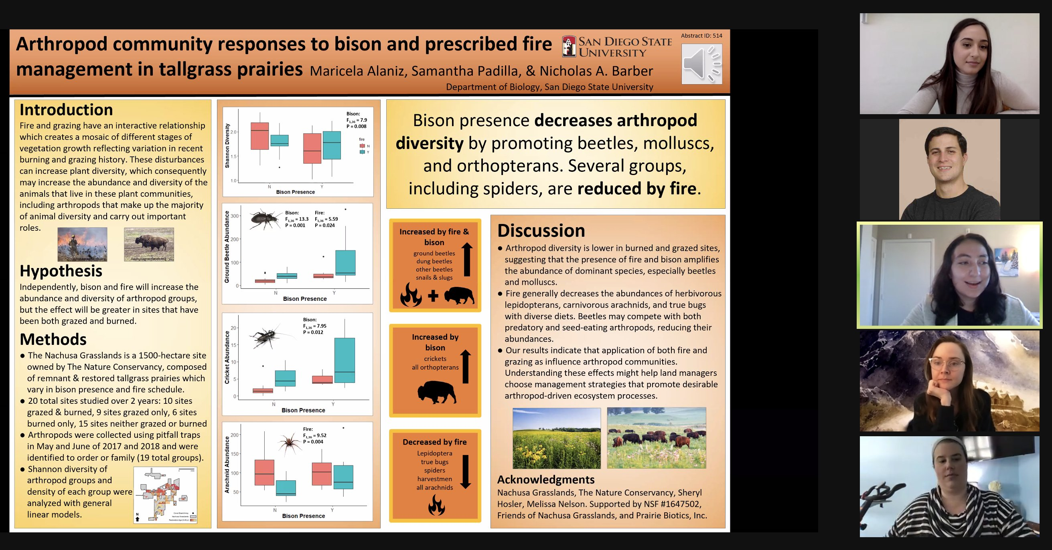
Status of Current Knowledge
Nick Barber’s research group (now at San Diego State University)

Slide 13
Possible Goals
Quantify dung beetle community composition in landscapes grazed by bison or cattle
Compare dung beetle guilds (tunnelers are more effective recyclers)
Identify species that are good indicators of habitat/recycling?
Examine differences in (before and after treatments?):
A) Vegetation (biomass, community composition?)
B) Soil metrics (bulk density, textural, carbon?, nitrogen?)
C) Carbon sequestration?
D) Residual ivermectins and permethrins?
E) Dung decomposition
F) Dung beetles and wallows

Slide 14
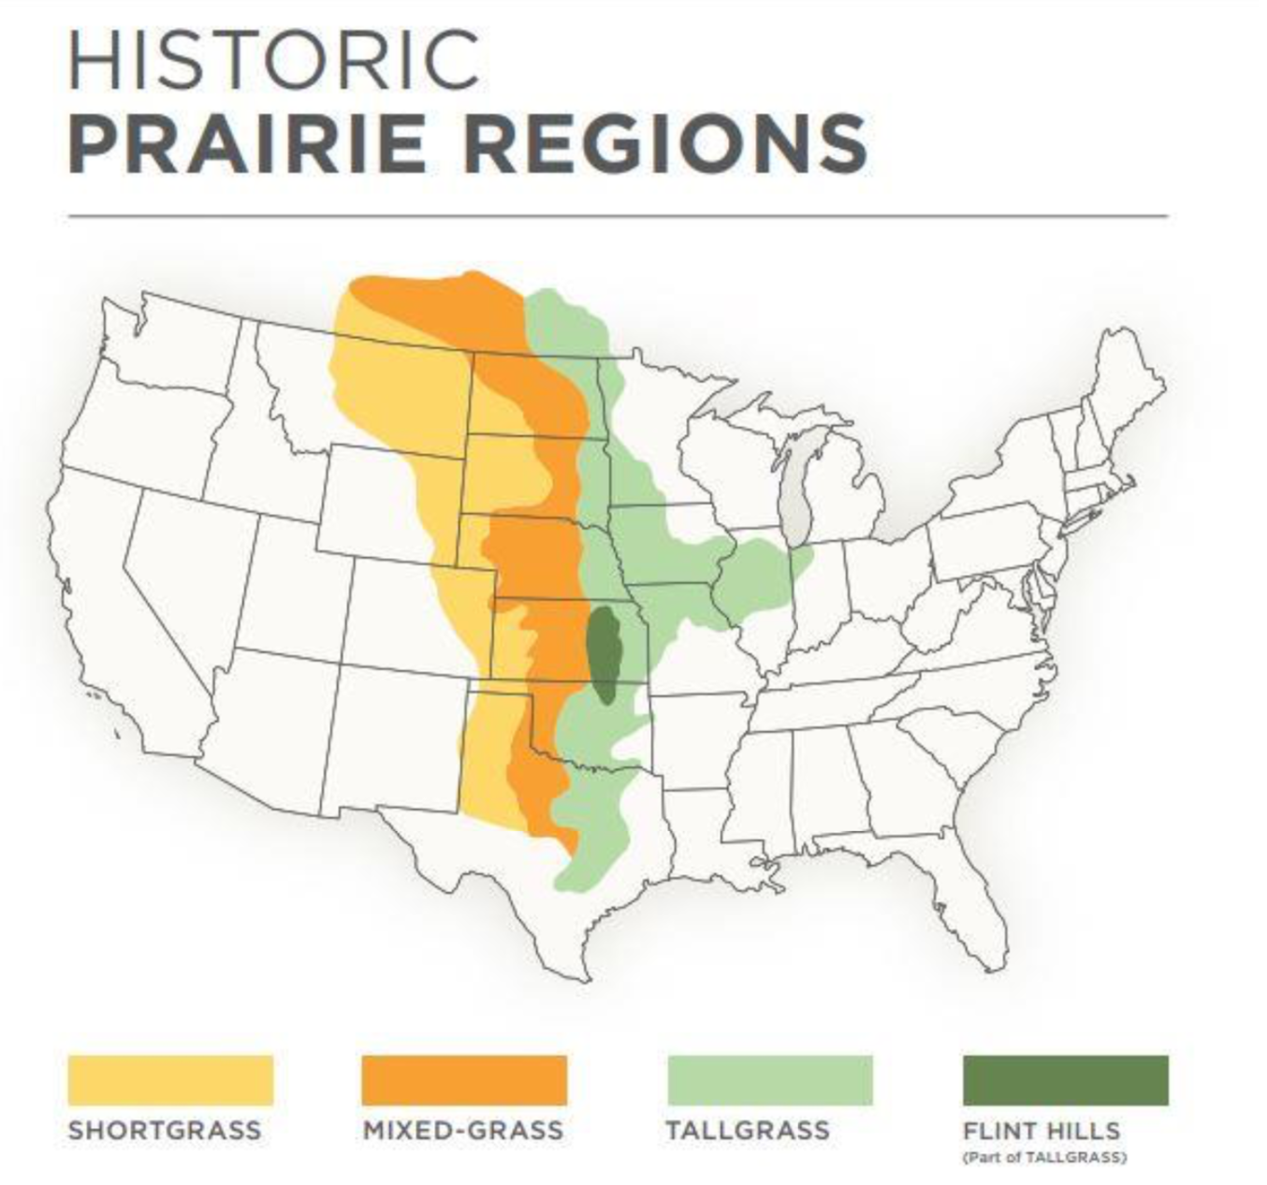
Location
North-south comparison
Northern shortgrass: Specific ecoregion?
Central tallgrass: Flint hills ecoregion
Comparison of grassland regions allows for stronger predictive ability to inform management and policy
https://www.flinthillsdiscovery.org/579/Flint-Hills-Map-Exhibits

Slide 15
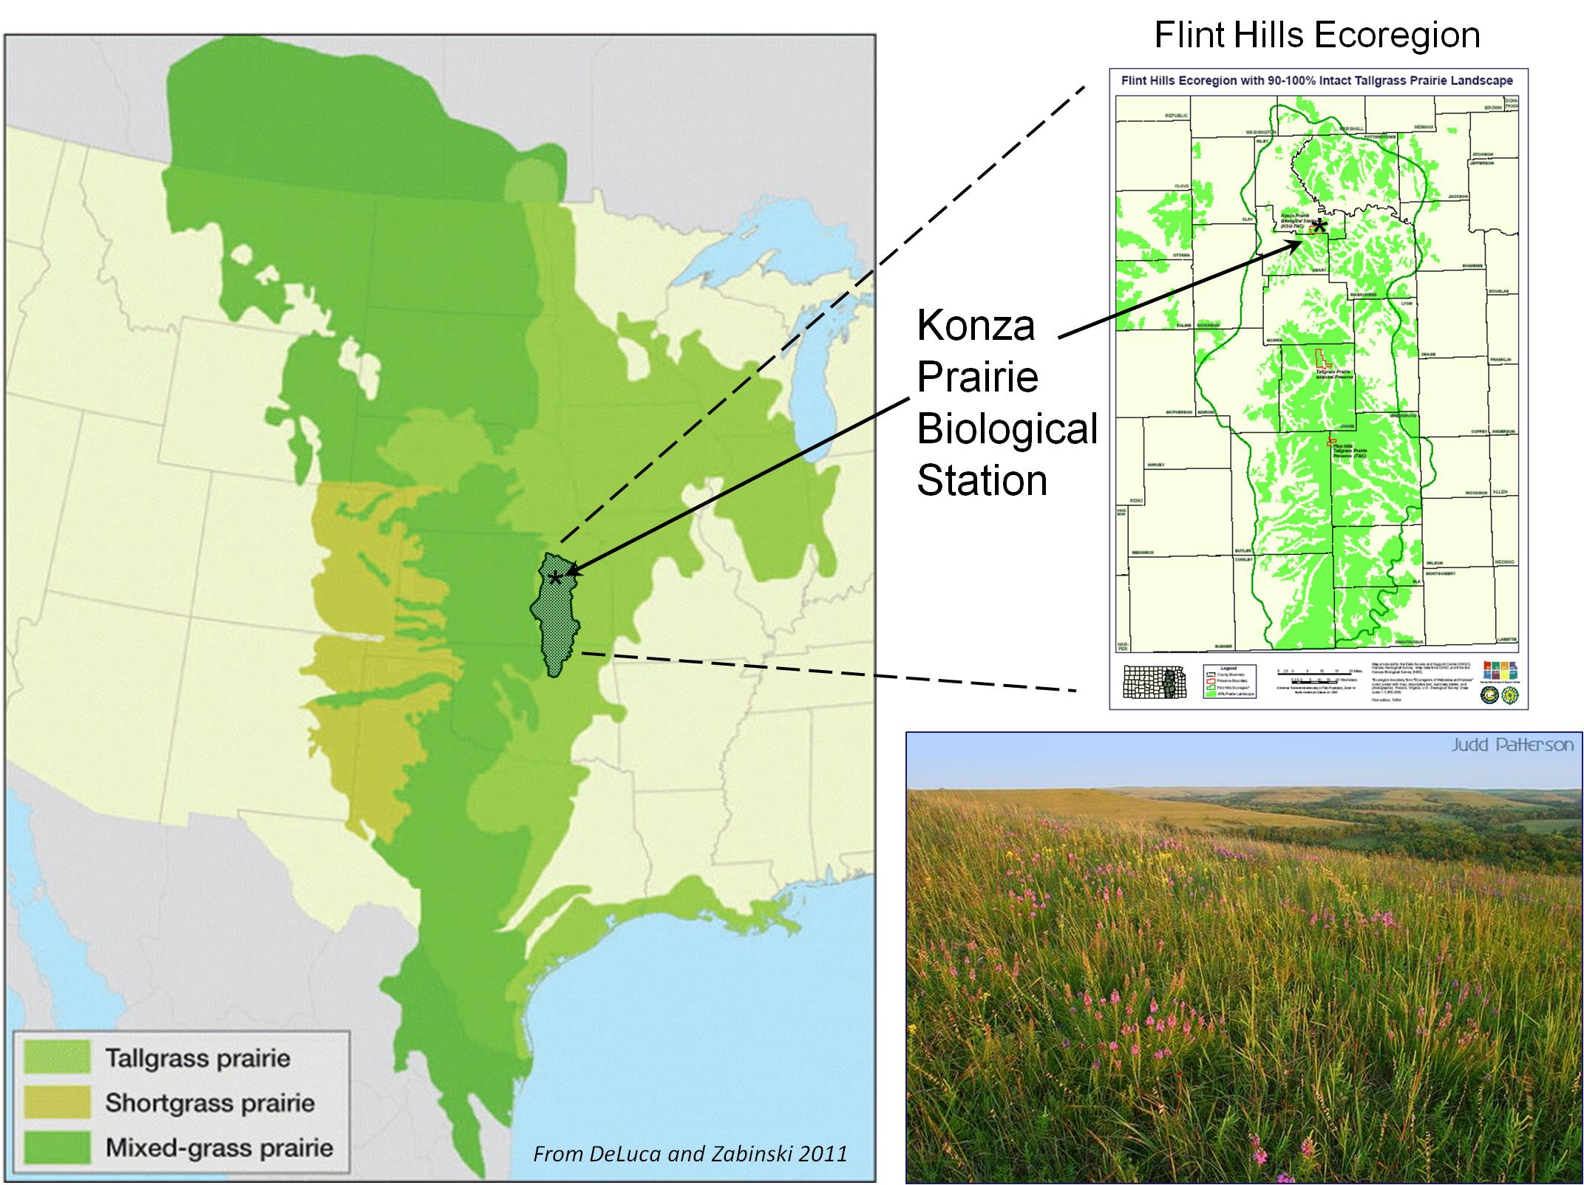
Flint Hills Locations
•All locations with cattle- and bison-grazing
•Are locations all prairie bison ranches rather than woodland bison?
•Need some info on use of dewormers
•Need some info on site history
•How many sites do we need?
Konza Biological Station, KS
Tallgrass Prairie National Preserve, KS
Flinthills Prairie Preserve (TNC), KS
Youngmeyer Ranch (WSU), KS
Tallgrass Prairie Preserve, OK
Bluestem Ranch (TT), OK
https://deims.org/a635d4dc-6a74-4947-b3d1-5c88b3a441c7
Notes:
From Shelly Wiggam on Jan. 21, 2022
Regarding TNC sites that have both bison and cattle grazing:
I’ll go ahead and jump in here because I know all others on this thread are slammed right now
TNC has three field sites in the Flint Hills Ecoregion that have both bison and cattle grazing units at each field site:
Konza Prairie Biological Station (Riley and Geary Counties, KS);
Tallgrass Prairie National Preserve (CS County, KS), and;
Tallgrass Prairie Preserve (Osage County, OK). Tallgrass Prairie Preserve is in OK, but only barely south of the border.
If you’d like, and others on this thread are okay with it, I’d be very happy to facilitate you getting into contact with the right people to discuss possibilities and options – I have worked with/on all three preserves (and with the people at each) extensively over the last 22 years, but totally understand if you and/or others on this thread would like to facilitate
Regarding Non-TNC bison and cattle operations/areas in Tallgrass, Mixed Grass, Short Grass:
If you would like private lands sites with both bison and cattle grazing units that are not part of TNC and/or are in different Prairie Ecosystem types, I’d be happy to connect you with people – just holler if so!

Slide 16
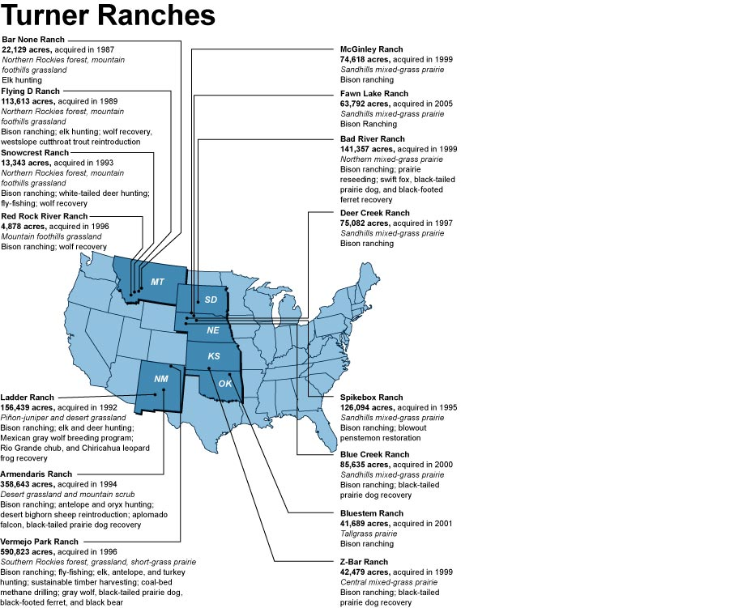
Short grass Locations
•Need one ecoregion
•All locations need large landscapes cattle- and bison-grazing
•Are locations all prairie bison ranches rather than woodland bison?
•Need some info on use of dewormers
•Need some info on site history
•How many sites do we need?
•Turner may be willing to provide funding for the research. Including 1-2 Turner ranches may help grease the wheels!
https://shoeuntied.wordpress.com/2017/04/10/map-of-the-day-ted-turner-ranches/

Slide 17
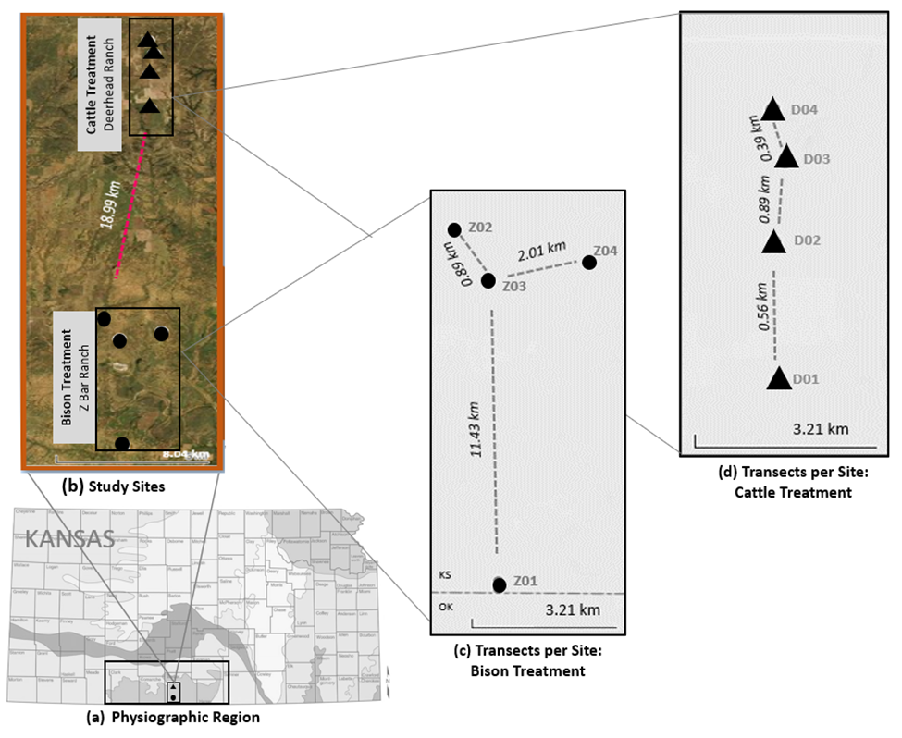
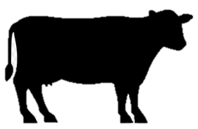
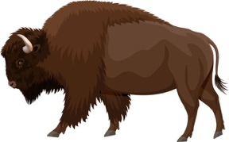
Sampling
How many sites in MT and KS (3-4)?
Consider independence of sites (at least 2 km)
Consider size of the pasture (size could be considered a covariate)

Slide 18
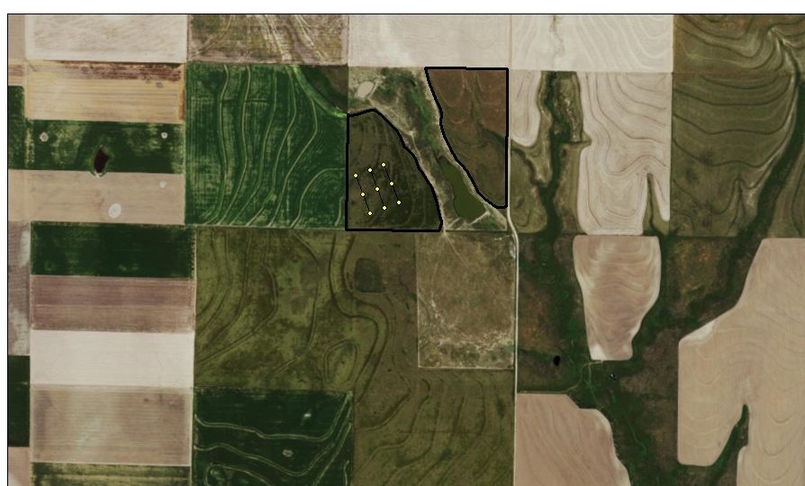
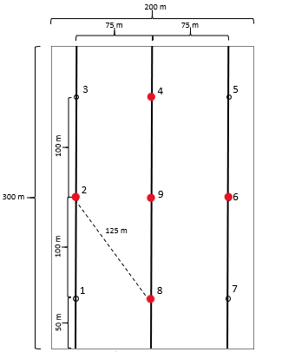
Sites, Plot, Transects
Sampling
200 x 300m plot
2 transects (200m)
9 sample points
- 4 with pitfall traps
Notes:
If we zoom in a bit on a single one of our study fields this is what we see. The CRP land is outlined here in black with our study plot being represented by this yellow diagram. If we blow that up a bit more this is where we collected the data. It is a 200x300 meter plot with 9 sample points. We collected tons of data on everything from plant composition to soils but what my research is focused on is these 5 points here in red. Each of those points contained a pitfall trap which is a common way to sample ground dwelling insects.

Slide 19
Transect Idea
How many transects per site?
North-south orientation?

Slide 20
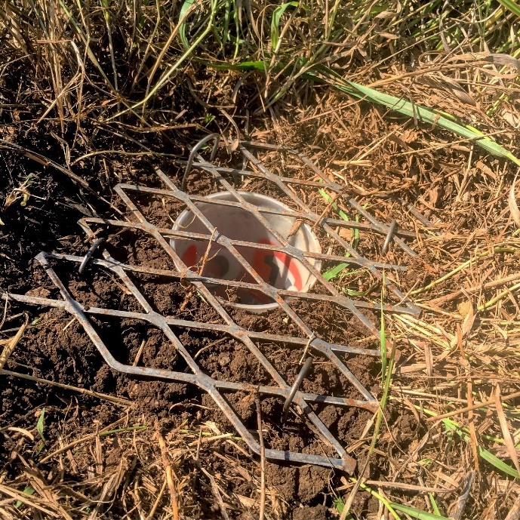
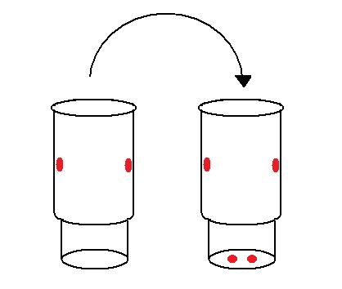
Transect Idea
How many sample points (pitfalls) per transect? Consider insect biomass and identification
How many sampling events per site? Consider insect biomass and identification
Duration of sampling?

Slide 21
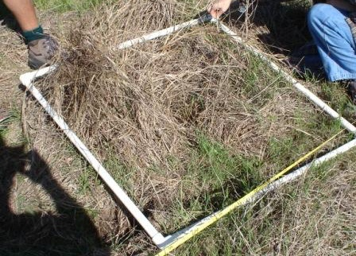
Transect Idea
What environmental factors should be examined? How often?

Slide 22
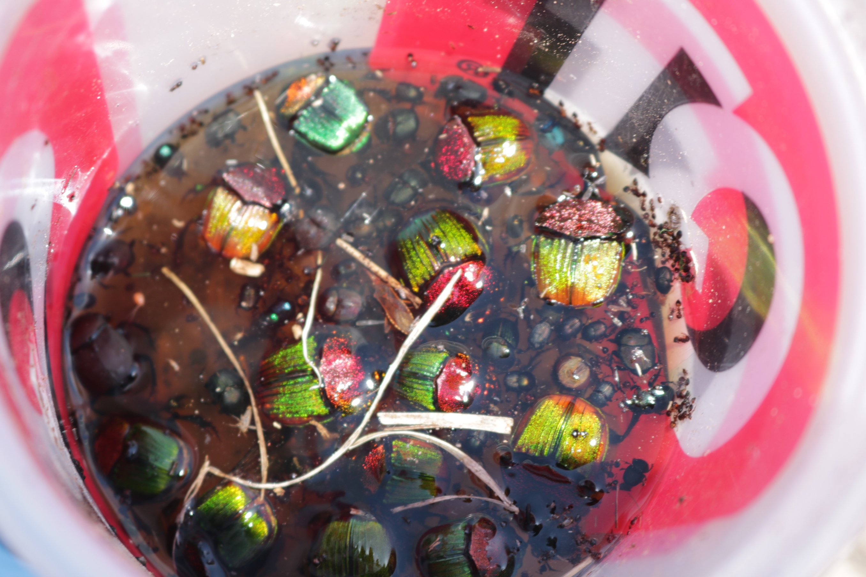
Insect Processing
How do we define “dung beetles”?
Scarabaeinae
Or
Scarabaeinae+Aphodiinae
Or
Scarabaeinae+Geotrupinae
What about by-catch? Save or delete?
Vouchers/repeatability

Slide 23
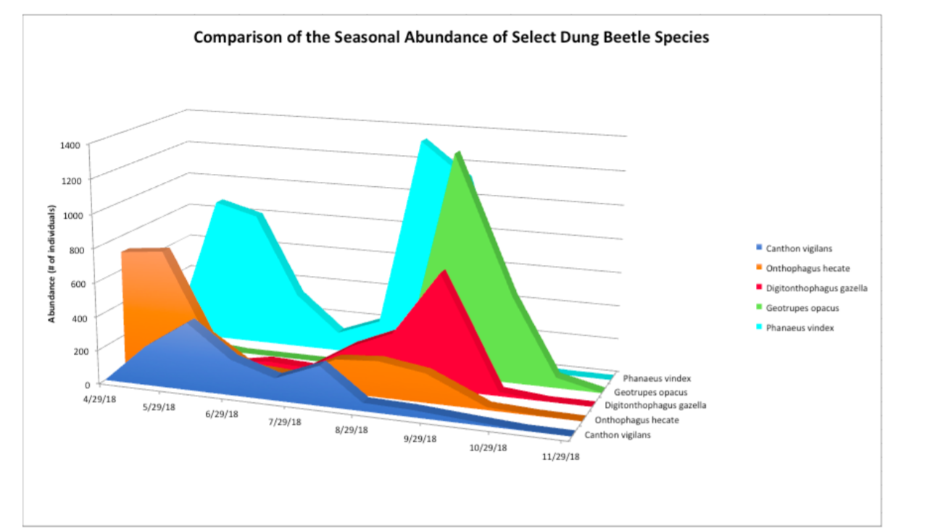
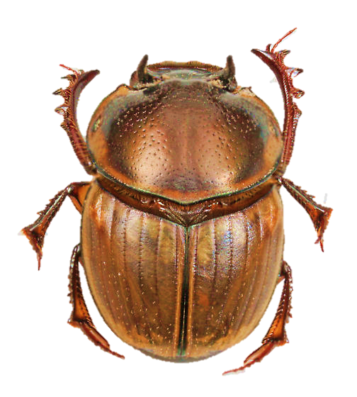
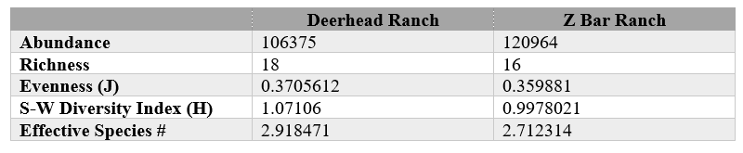
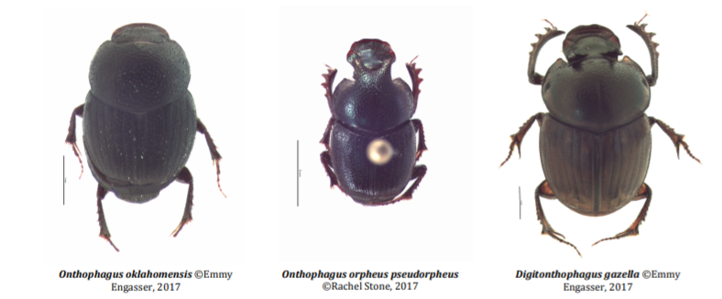
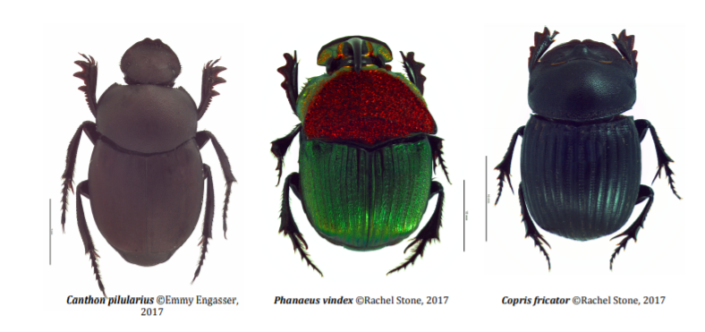
Diversity and Abundance
~227,000 beetles representing 18 total species
Digitonthophagus gazella
Bimodal phenology in Kansas Red Hills (May and September)

Slide 24
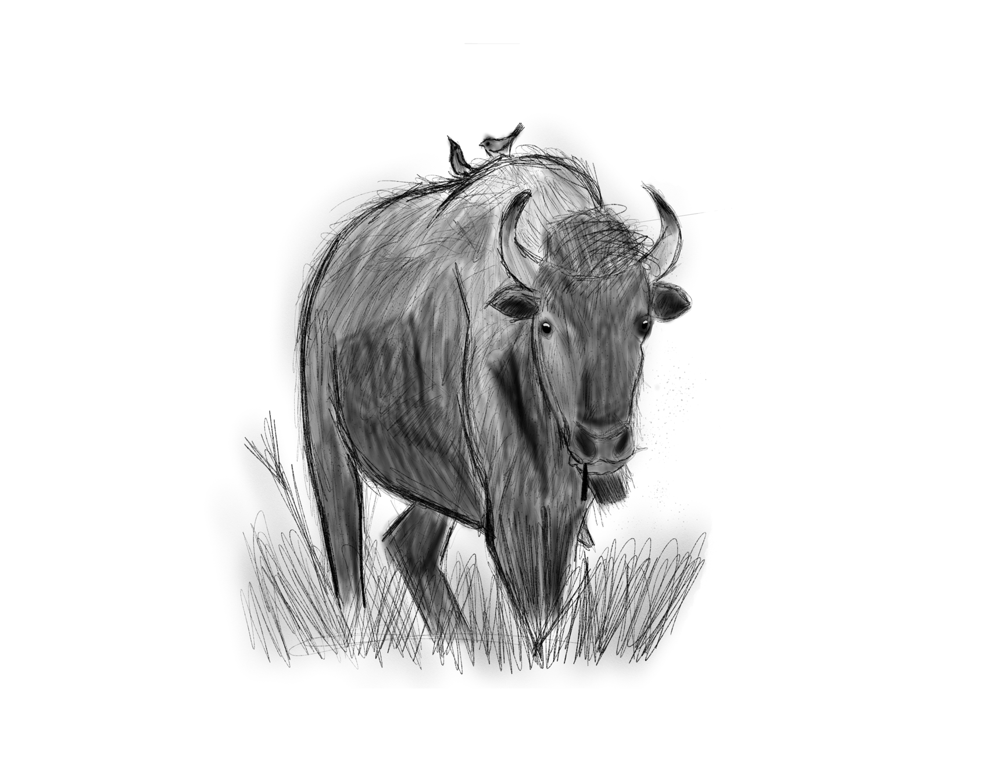
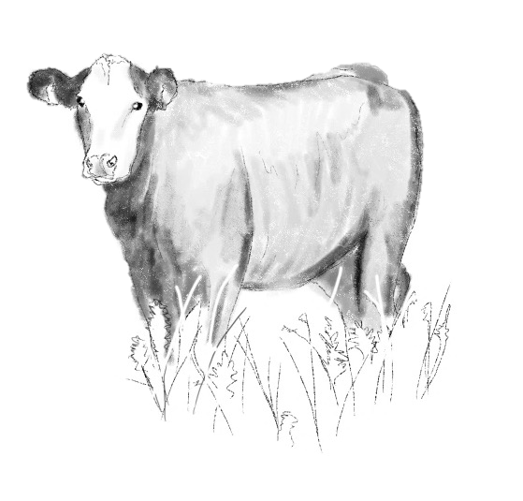
1) Do dung beetle community structure and composition differ on bison grazed versus cattle grazed grasslands?
Over 220,000 individual dung beetles over a full season of dung beetle activity (April – December)
No significant difference in community richness, evenness, and diversity measures for the cattle-grazed and bison-grazed treatments.
Notes:
Corroborates findings of Tiberg and Floate

Slide 25
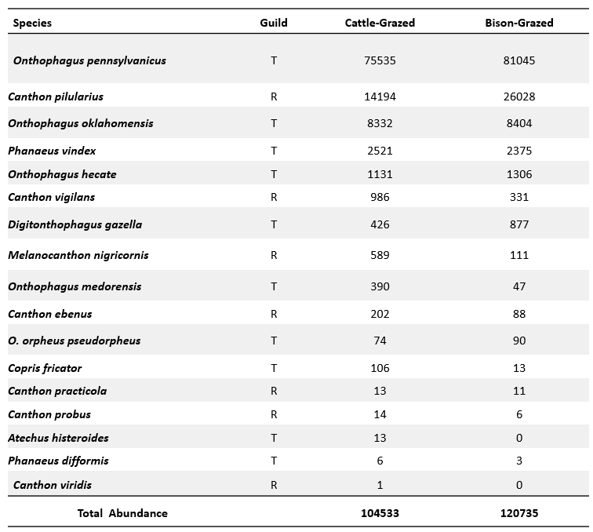

1) Do dung beetle community structure and composition differ on bison grazed versus cattle grazed grasslands?
Some dung beetle species are much more common than others. Some species are significantly more abundant at one grazing treatment than the other.

Slide 26
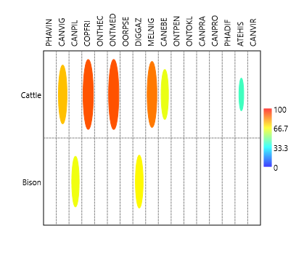
1) Do dung beetle community structure and composition differ on bison grazed versus cattle grazed grasslands?
Some dung beetle species are highly associated with the cattle grazed treatments and two dung beetles are associated with the bison grazed treatments.
IndVal analysis in PAST: species associated with cattle grazed or bison grazed treatment. Species showing significant association with treatment (p ≤ 0.05) indicated with colored ovals.

Slide 27
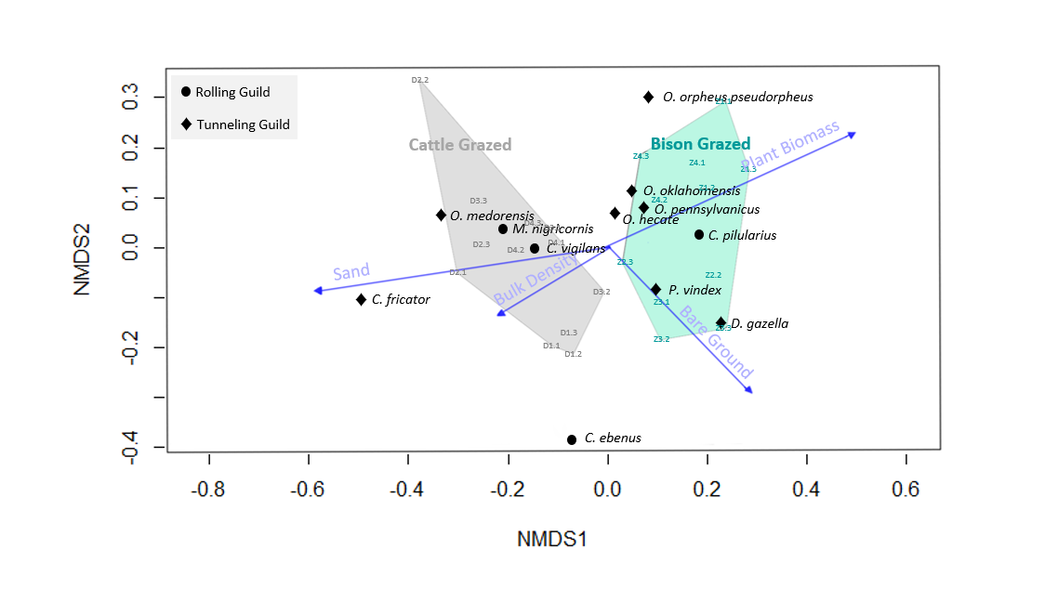

1) Do dung beetle community structure and composition differ on bison grazed versus cattle grazed grasslands?
Notes:
Explain NMDS and differences in dung beetle communities. Cattle grazed treatment does not overlap with the bison grazed treatment. Abundance shows no difference between two treatments. But when we look at these communities we see they are different. Compared with the univariate analysis this shows there are differences in communities.

Slide 28
1) Do dung beetle community structure and composition differ on bison grazed versus cattle grazed grasslands?
TWO GRAZING TREATMENTS
Notes:
Longer Vector = more influence on dung beetle communities

Slide 29
1) Do dung beetle community structure and composition differ on bison grazed versus cattle grazed grasslands?
24 SAMPLE POINTS
Notes:
Longer Vector = more influence on dung beetle communities

Slide 30
1) Do dung beetle community structure and composition differ on bison grazed versus cattle grazed grasslands?
FOUR ENVIRONMENTAL FACTORS
Notes:
Longer Vector = more influence on dung beetle communities

Slide 31
1) Do dung beetle community structure and composition differ on bison grazed versus cattle grazed grasslands?
12 DUNG BEETLE SPECIES (n ≥ 25) & FUNCTIONAL GUILD
Notes:
Longer Vector = more influence on dung beetle communities

Slide 33
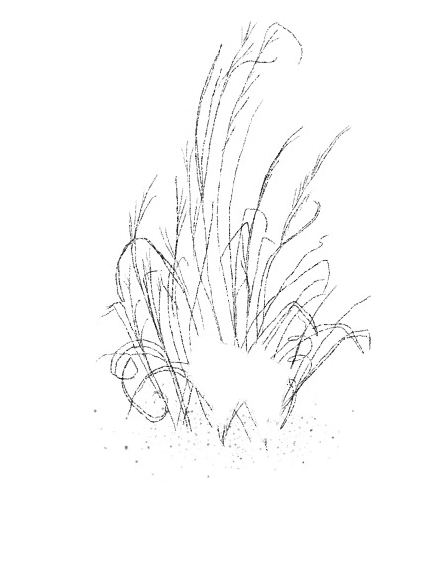
2) Is dung beetle abundance associated with the interactions of grazers with their environment,
including the habitat surface, the soil interface, and the rhizosphere?

Slide 34
2) Is dung beetle abundance associated with the interactions of grazers with their environment,
including the habitat surface, the soil interface, and the rhizosphere?

Slide 35
Funding sources?
https://www.farmprogress.com/conservation/grants-help-ranchland-trust-launch-western-kansas-project
https://www.landcan.org/Grant-and-Assistance-Programs/
https://www.nfwf.org/trending-topics/working-ranch-lands (go to the bottom of the page)
https://www.federalgrants.com/Farms-and-Ranch-Lands-Protection-Program-5846.html
https://www.nrcs.usda.gov/wps/portal/nrcs/detail/null/?cid=nrcs141p2_018768
https://www.federalgrantswire.com/farmland-protection-program.html#.YY2E5tbMKu4
https://farmraise.com/?gclid=CjwKCAiAm7OMBhAQEiwArvGi3LoGmzmOf4Fu_73hPevza62DIxdSCi-Qrv6HiF1I05qRPEW6IG-qaRoCXwkQAvD_BwE
https://www.tpl.org/about/farm-and-ranch-lands-protection-program-frpp
Caesar kleberg wildlife research institute (https://www.ckwri.tamuk.edu/)
SARE https://www.sare.org/grants/
Tallgrass Alliance
Savory Institute

Slide 36
Broader impacts
Dung beetle workshop for ranchers and farmers
Popular book?
Training students in dung beetle identification?

Slide 37
Some References
Barber, N. A., Hosler, S. C., Whiston, P., & Jones, H. P. (2019). Initial responses of dung beetle communities to bison reintroduction in restored and remnant tallgrass prairie. Natural Areas Journal, 39(4), 420-428.
Guiden, P. W., Barber, N. A., Blackburn, R., Farrell, A., Fliginger, J., Hosler, S. C., ... & Jones, H. P. (2021). Effects of management outweigh effects of plant diversity on restored animal communities in tallgrass prairies. Proceedings of the National Academy of Sciences, 118(5).
Hosler, S. C., Jones, H. P., Nelson, M., & Barber, N. A. (2021). Management actions shape dung beetle community structure and functional traits in restored tallgrass prairie. Ecological Entomology, 46(2), 175-186.
Tiberg, K., & Floate, K. D. (2011). Where went the dung-breeding insects of the American bison?. The Canadian Entomologist, 143(5), 470-478.
Trible, M. L. (2021). Effects of bison, cattle, and environmental factors on grassland dung beetle abundance and community structure (MS Thesis, Wichita State University).

Slide 39
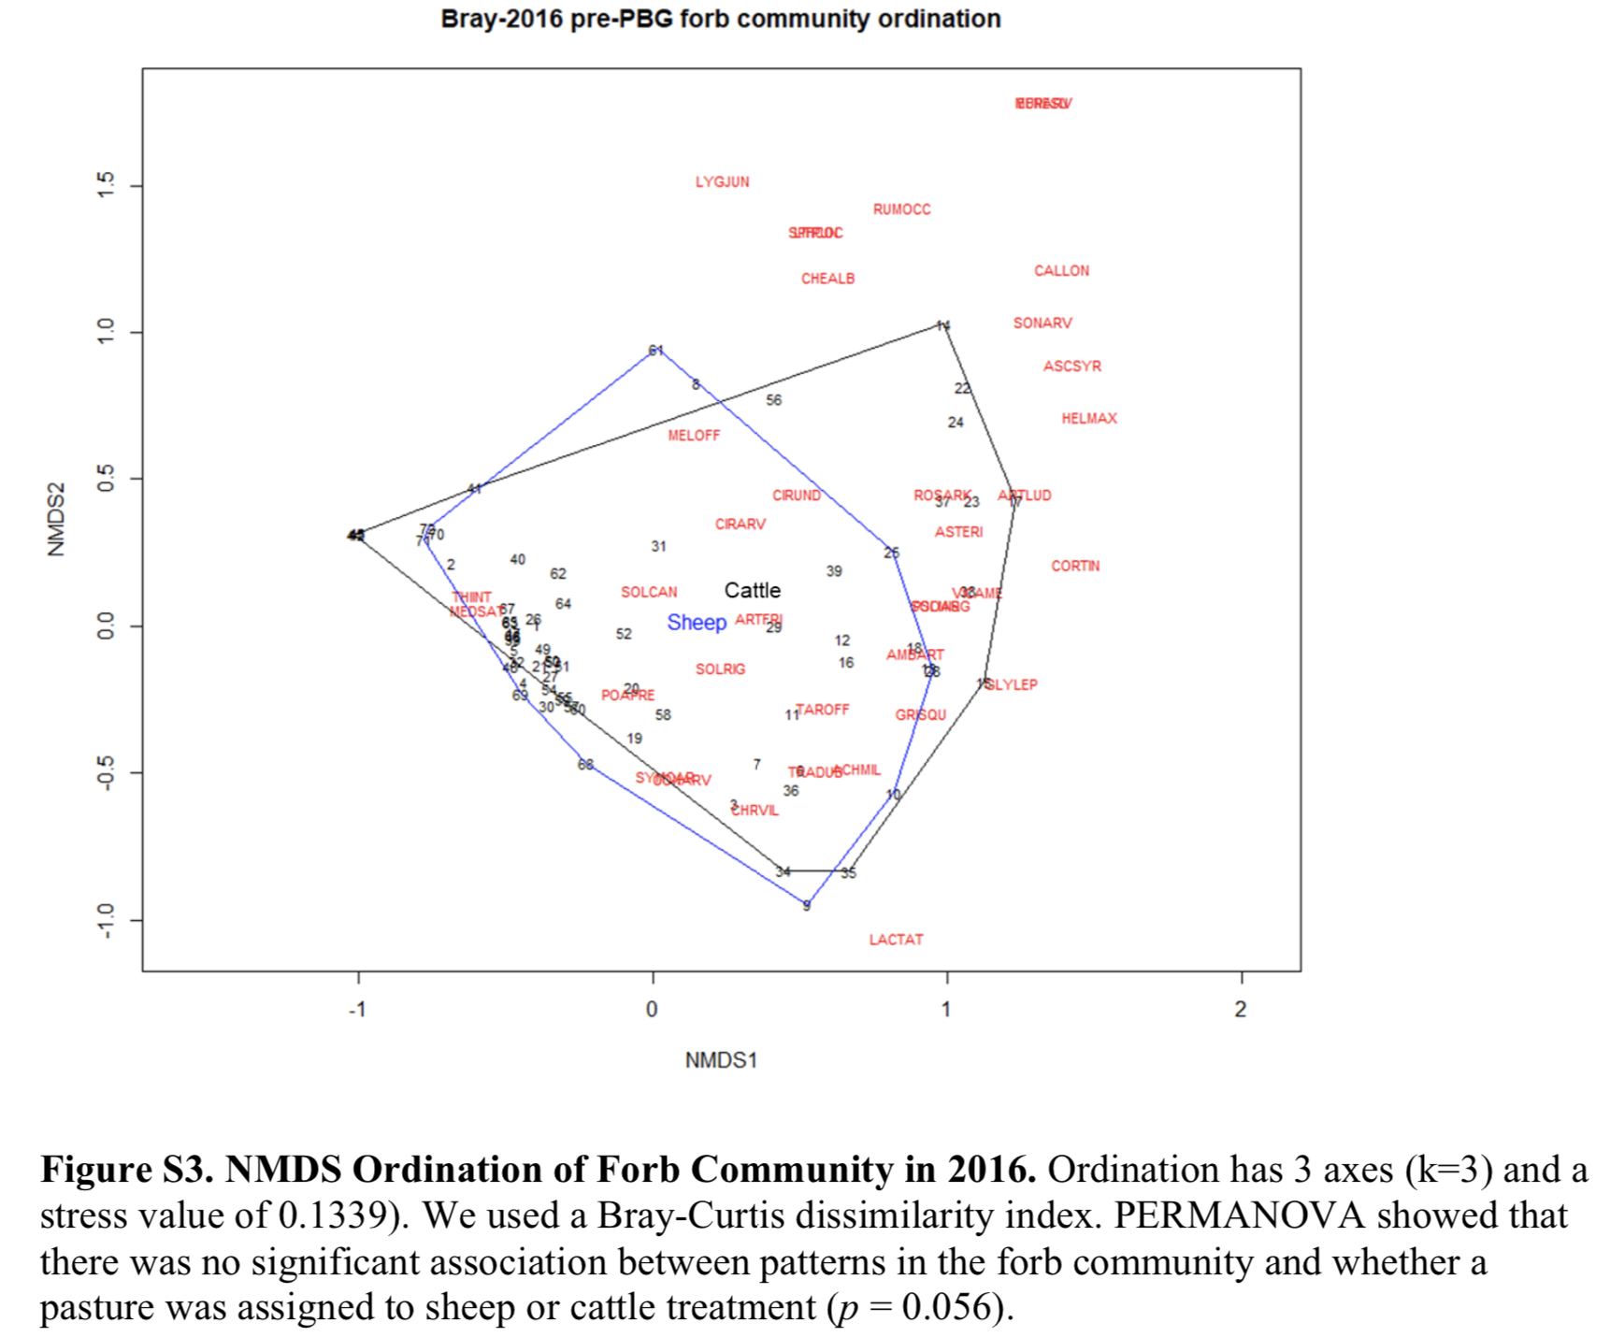
Conduct vegetation analysis before treatment? The research had no control site (from Cutter et al. 2021)

Slide 40
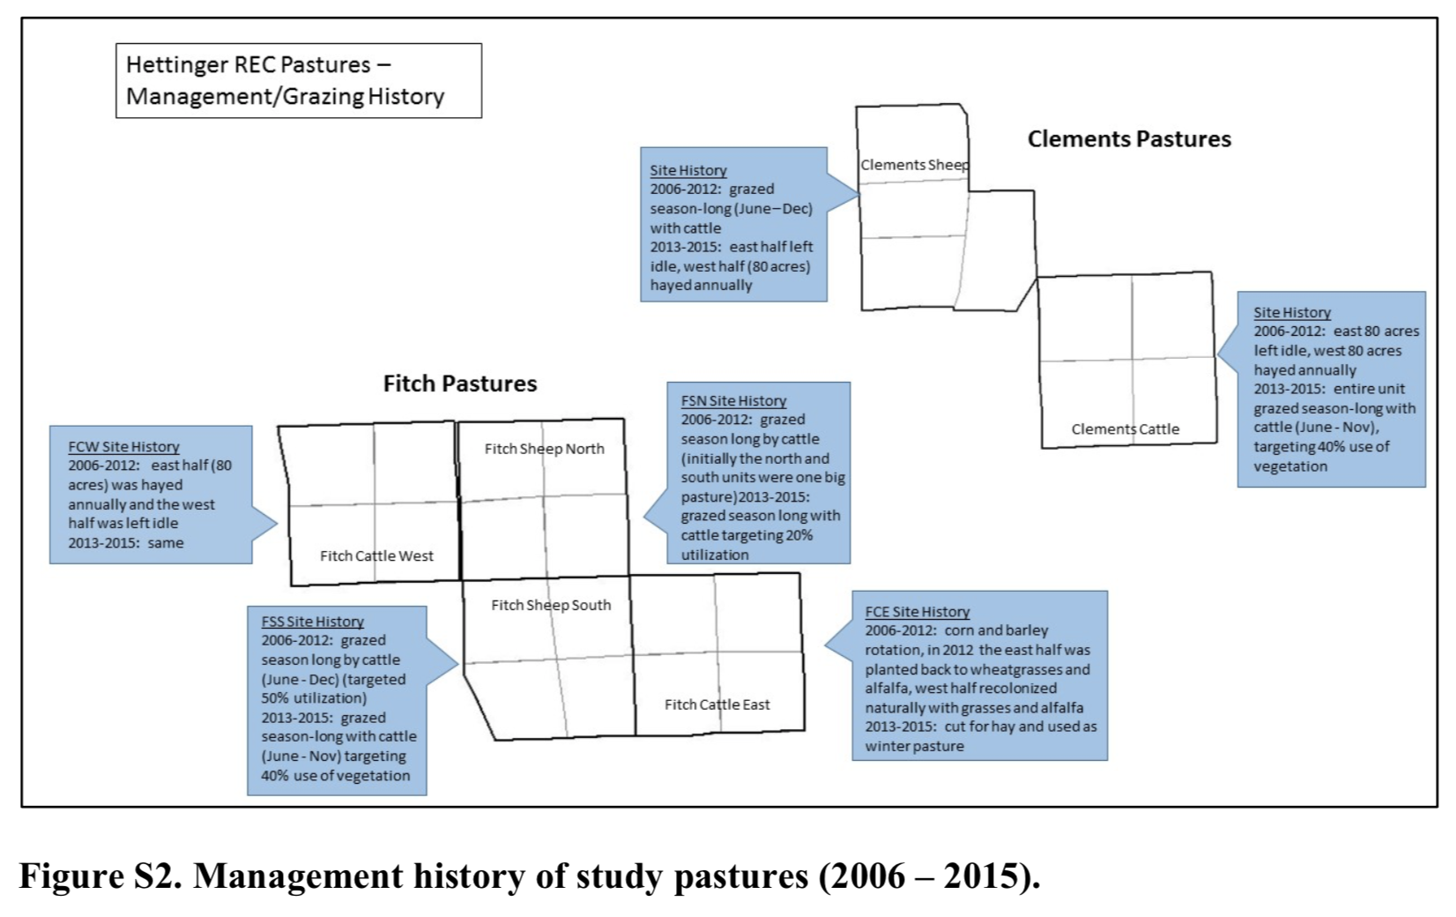
Idea for study sites in supplemental documents (from Cutter et al. 2021).

